Slide 1
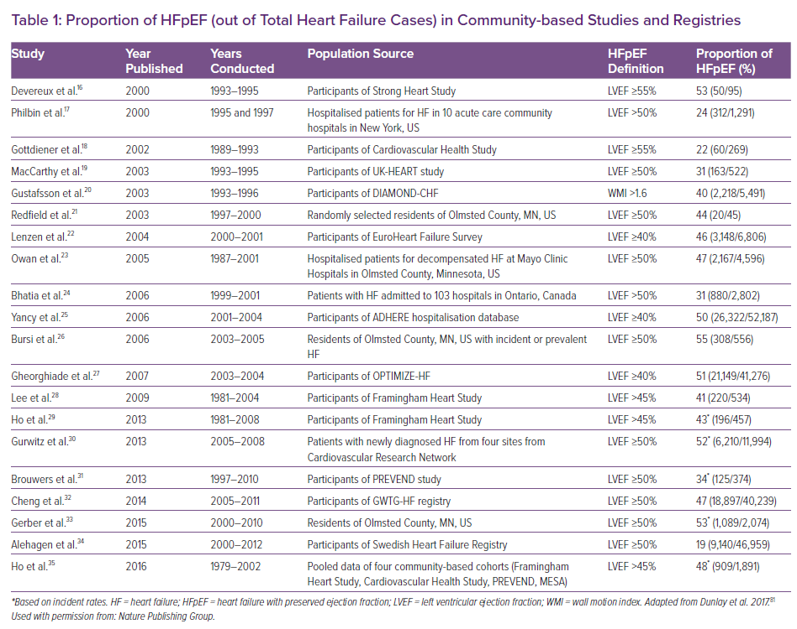
Teramoto K, Teng THK, Chandramouli C, Tromp J, Sakata Y, Lam CS
Proportion of HFpEF (out of Total Heart Failure Cases) in Community-based Studies and Registries
Citation: Cardiac Failure Review 2022;8:e27.
https://doi.org/10.15420/cfr.2022.06

