Slide 1
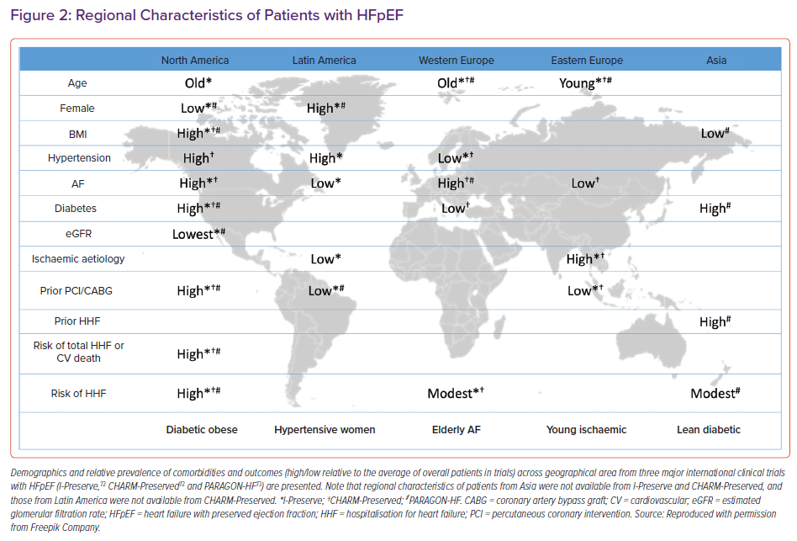
Teramoto K, Teng THK, Chandramouli C, Tromp J, Sakata Y, Lam CS
Regional Characteristics of Patients with HFpEF
Citation: Cardiac Failure Review 2022;8:e27.
https://doi.org/10.15420/cfr.2022.06

