Slide 1
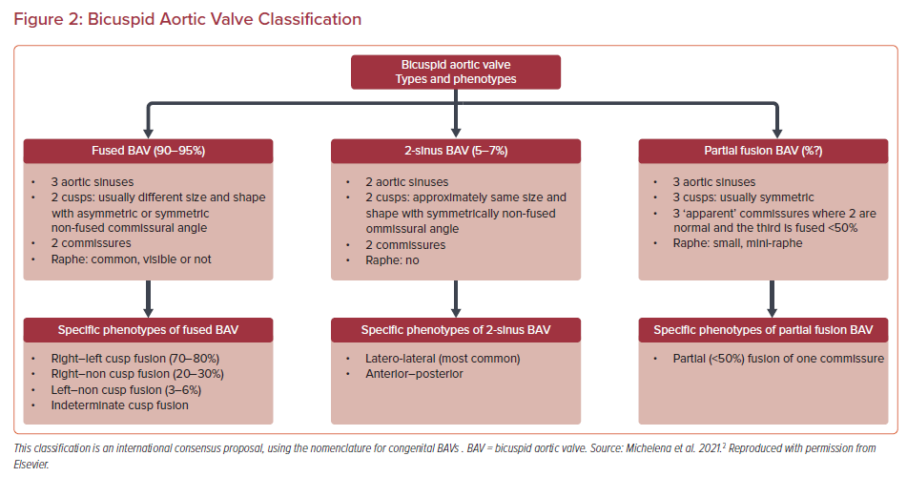
Lee AJ, Baig I, Harrington KB, Szerlip M
Bicuspid Aortic Valve Classification
Citation: US Cardiology Review 2022;16:e21.
https://doi.org/10.15420/usc.2021.32

