Slide 1
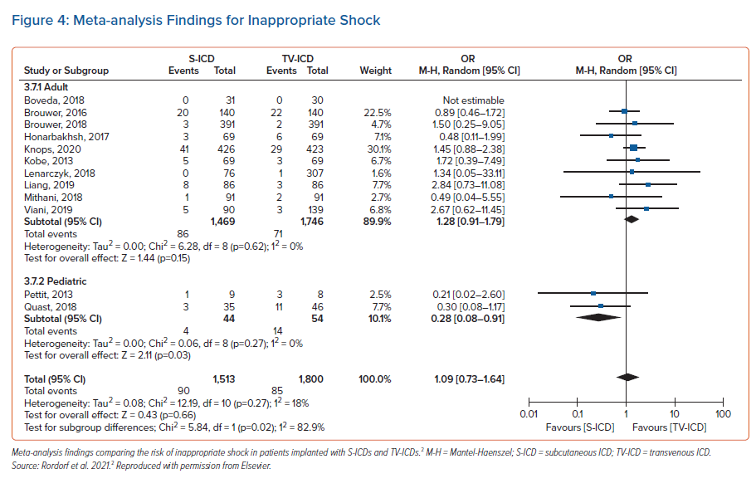
Rordorf R
Meta-analysis Findings for Inappropriate Shock
Citation: Arrhythmia & Electrophysiology Review 2022;11(Suppl 1):1–7.
https://doi.org/10.15420/aer.2022.11.S1

