Slide 1

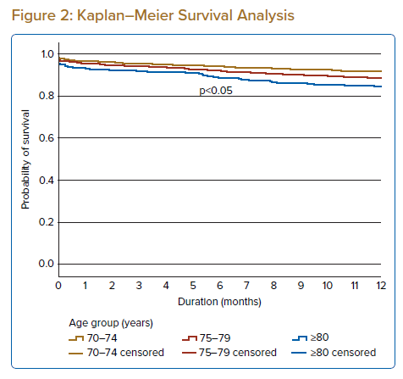
Palaniappan G, Sundran RM, Ashari A, Jalaluddin MS, Haroon AY, Stanislaus R, Tey YS, Abdul Hamid AF, Lee TJ, Yahaya SA, Kandasamy B, Zainal Z
Kaplan–Meier Survival Analysis
Citation: Journal of Asian Pacific Society of Cardiology 2022;1:e20.
https://doi.org/10.15420/japsc.2021.34

