Slide 1
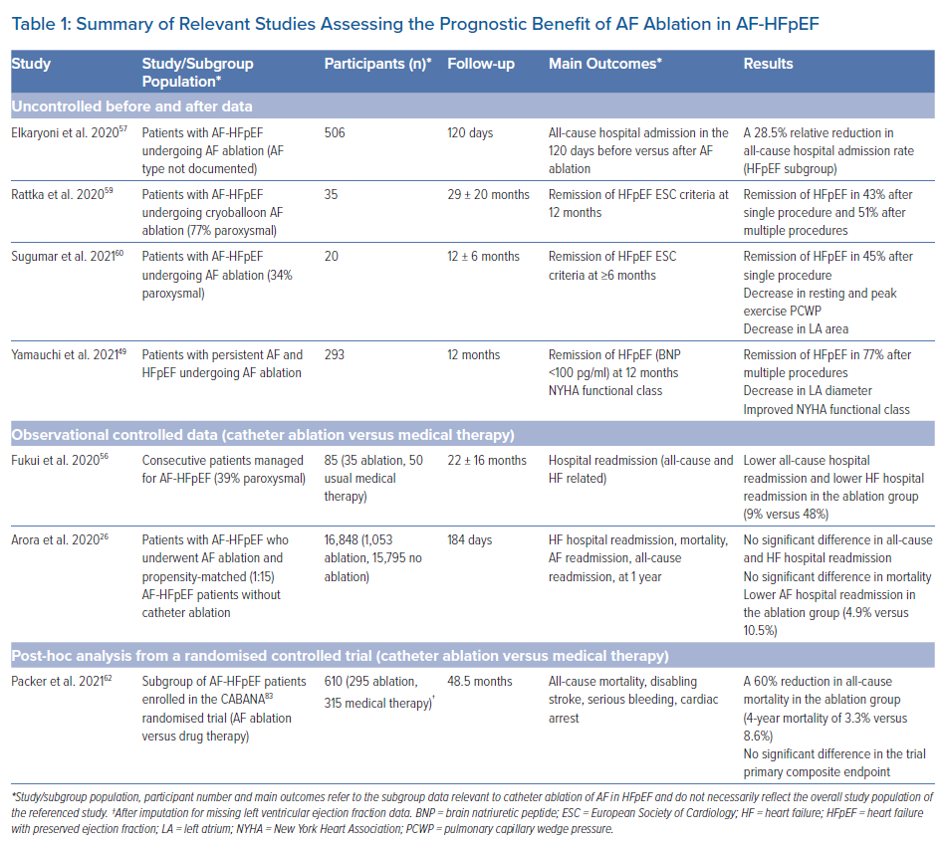
Johner N, Namdar M, Shah D
Summary of Relevant Studies Assessing the Prognostic Benefit of AF Ablation in AF-HFpEF
Citation: Arrhythmia & Electrophysiology Review 2022;11:e18.
https://doi.org/10.15420/aer.2022.10

