Slide 1
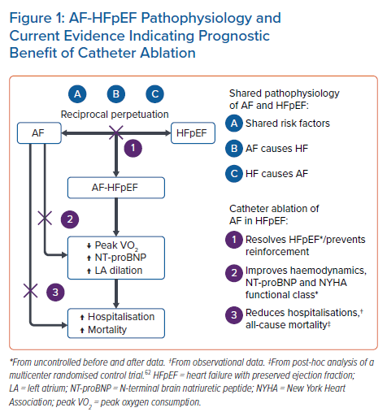
Johner N, Namdar M, Shah D
AF-HFpEF Pathophysiology and Current Evidence Indicating Prognostic Benefit of Catheter Ablation
Citation: Arrhythmia & Electrophysiology Review 2022;11:e18.
https://doi.org/10.15420/aer.2022.10

