Slide 1
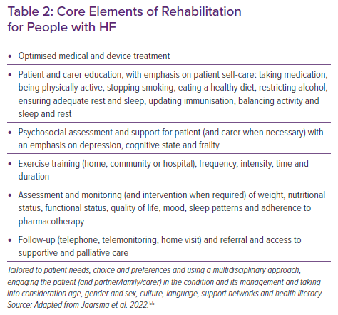
Thompson DR, Ski CF, Clark AM, Dalal HM, Taylor RS
Core Elements of Rehabilitation for People with HF
Citation: Cardiac Failure Review 2022;8:e28.
https://doi.org/10.15420/cfr.2022.16

