Slide 1
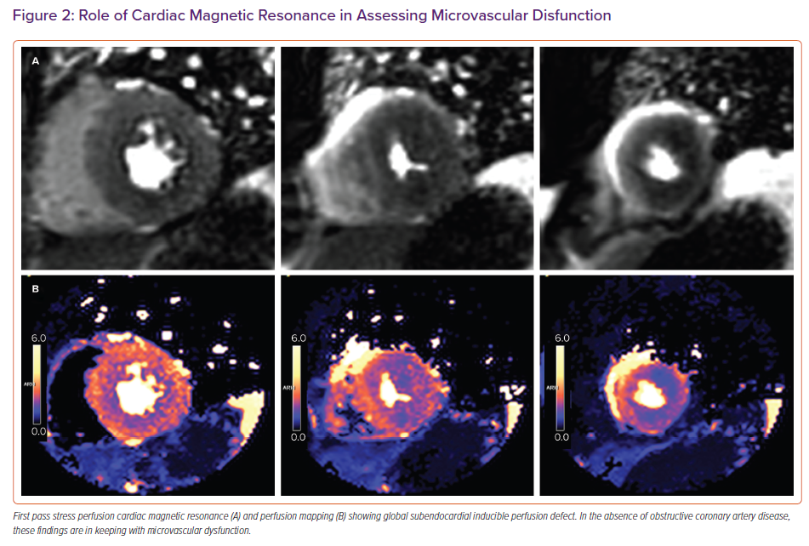
Leo I, Nakou E, Marvao Ad, Wong J, Bucciarelli-Ducci C
Role of Cardiac Magnetic Resonance in Assessing Microvascular Disfunction
Citation: Cardiac Failure Review 2022;8:e29.
https://doi.org/10.15420/cfr.2022.17

