Slide 1
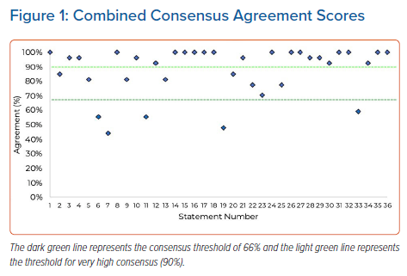
Roberts P, ElRefai MH, Foley P, Rao A, Sharman D, Somani R, Sporton S, Wright G, Zaidi A, Pepper C
Combined Consensus Agreement Scores
Citation: Arrhythmia & Electrophysiology Review 2022;11:e19.
https://doi.org/10.15420/aer.2022.17

