Slide 1
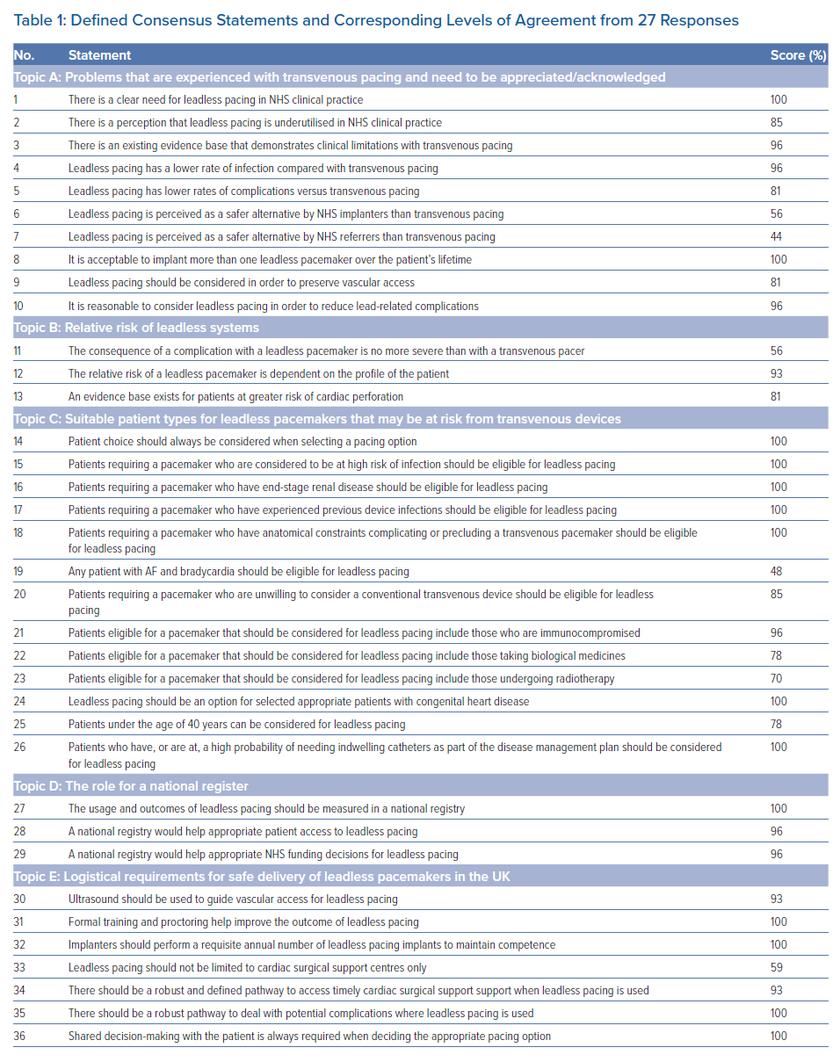
Roberts P, ElRefai MH, Foley P, Rao A, Sharman D, Somani R, Sporton S, Wright G, Zaidi A, Pepper C
Defined Consensus Statements and Corresponding Levels of Agreement from 27 Responses
Citation: Arrhythmia & Electrophysiology Review 2022;11:e19.
https://doi.org/10.15420/aer.2022.17

