Slide 1

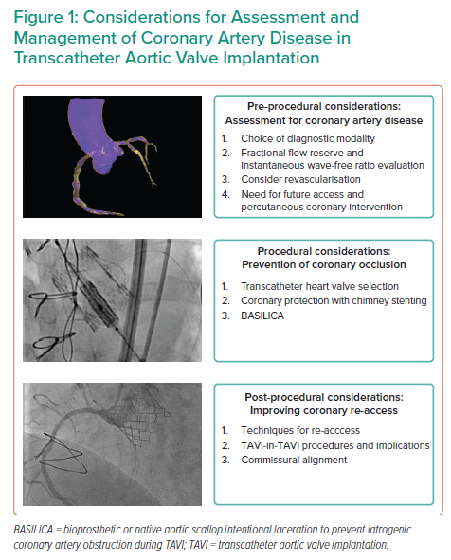
Lim Y, Tan KA, Kuntjoro I, Hon JK, Yip J, Tay EL
Considerations for Assessment and Management of Coronary Artery Disease in Transcatheter Aortic Valve Implantation
Citation: Interventional Cardiology 2022;17:e13.
https://doi.org/10.15420/icr.2021.25

