Slide 1
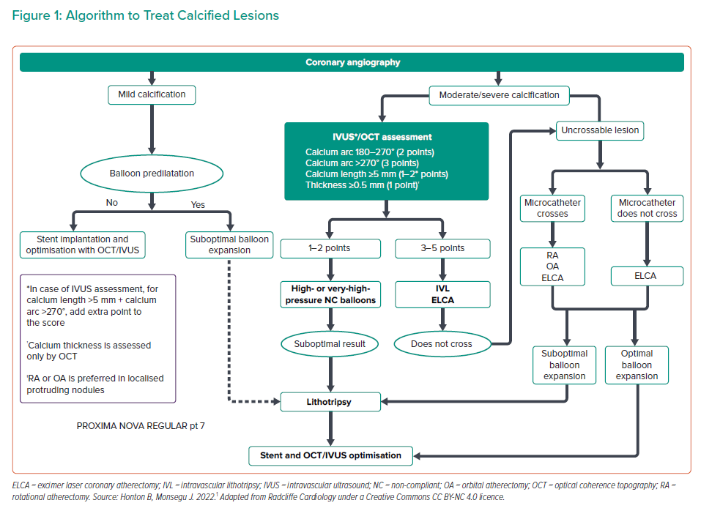
Vera-Vera S, Garcia A, Jimenez-Valero S, Galeote G, Moreno R, Jurado Román A
Algorithm to Treat Calcified Lesions
Citation: Interventional Cardiology 2022;17:e14.
https://doi.org/10.15420/icr.2022.10

