Slide 1
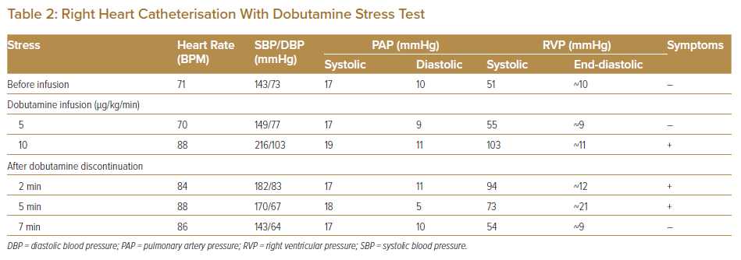
Yasuda K, Watanabe T, Takami A, Akasaka T, Yoshikawa Y, Nishimura M, Yamamoto K
Right Heart Catheterisation With Dobutamine Stress Test
Citation: Journal of Asian Pacific Society of Cardiology 2022;1:e22.
https://doi.org/10.15420/japsc.2022.03

