Slide 1
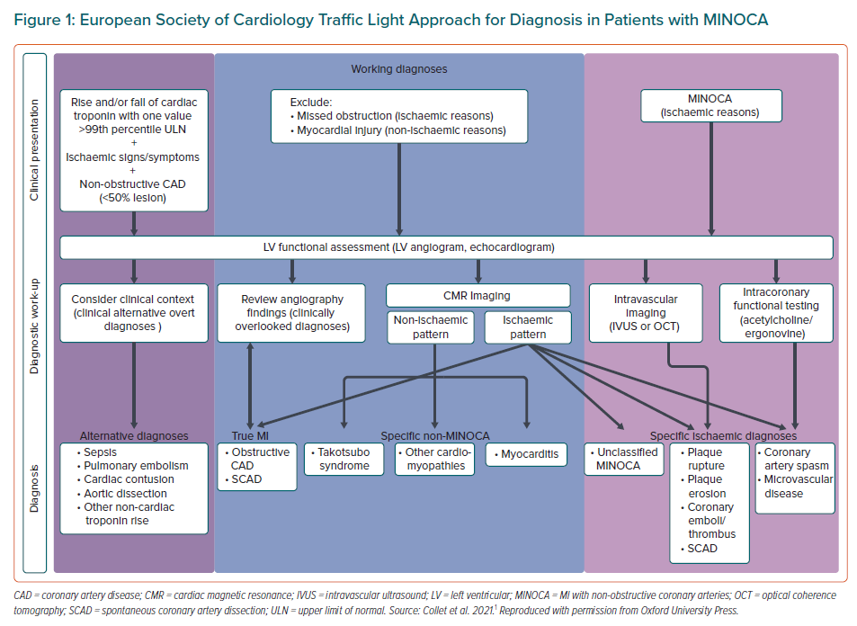
Ong P, Seitz A
European Society of Cardiology Traffic Light Approach for Diagnosis in Patients with MINOCA
Citation: European Cardiology Review 2022;17:e18.
https://doi.org/10.15420/ecr.2022.22

