Slide 1
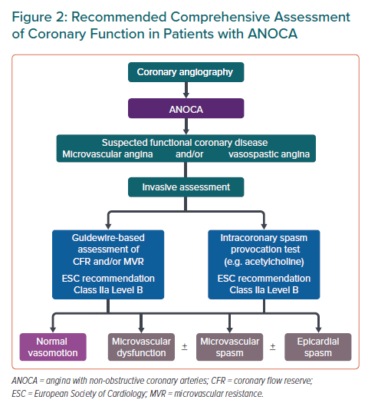
Ong P, Seitz A
Recommended Comprehensive Assessment of Coronary Function in Patients with ANOCA
Citation: European Cardiology Review 2022;17:e18.
https://doi.org/10.15420/ecr.2022.22

