Slide 1
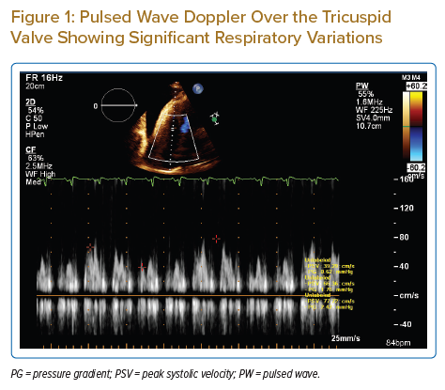
Qasim R, Alkatout K, Qaddoura F, Nagib A
Pulsed Wave Doppler Over the Tricuspid Valve Showing Significant Respiratory Variations
Citation: Journal of Asian Pacific Society of Cardiology 2022;1:e23.
https://doi.org/10.15420/japsc.2022.10

