Slide 1
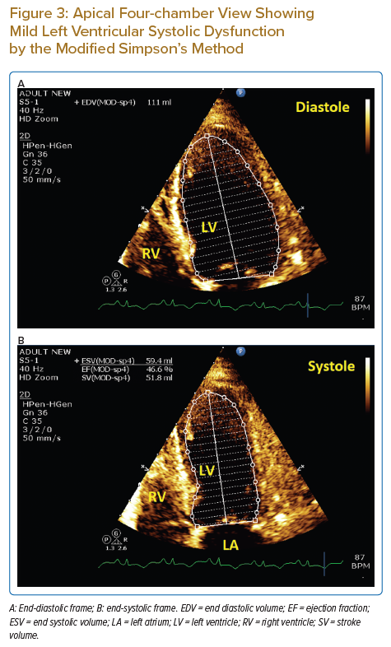
Qasim R, Alkatout K, Qaddoura F, Nagib A
Apical Four-chamber View Showing Mild Left Ventricular Systolic Dysfunction by the Modified Simpson’s Method
Citation: Journal of Asian Pacific Society of Cardiology 2022;1:e23.
https://doi.org/10.15420/japsc.2022.10

