Slide 1
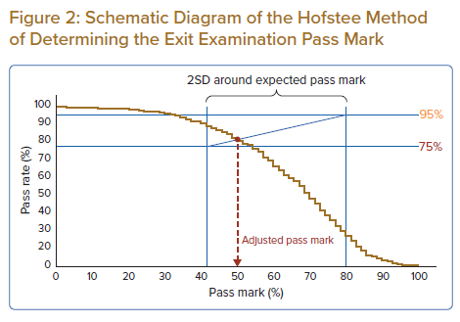
Tan JW, Yap JJL, Yeo KK, Chew DP, Fong AYY, Tan C, Shehab A, Nguyen QN, Chua T, Lawson C, Mathysen D, Thibault S, Almahmeed W, Plummer C
Schematic Diagram of the Hofstee Method of Determining the Exit Examination Pass Mark
Citation: Journal of Asian Pacific Society of Cardiology 2022;1:e24.
https://doi.org/10.15420/japsc.2022.15

