Slide 1
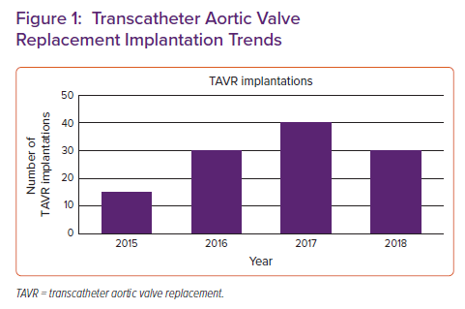
Rali AS, Taduru S, Tran LE, Ranka S, Schlendorf KH, Barker CM, Shah AS, Lindenfeld J, Zalawadiya SK
Transcatheter Aortic Valve Replacement Implantation Trends
Citation: Cardiac Failure Review 2022;8:e30.
https://doi.org/10.15420/cfr.2022.21

