Slide 1
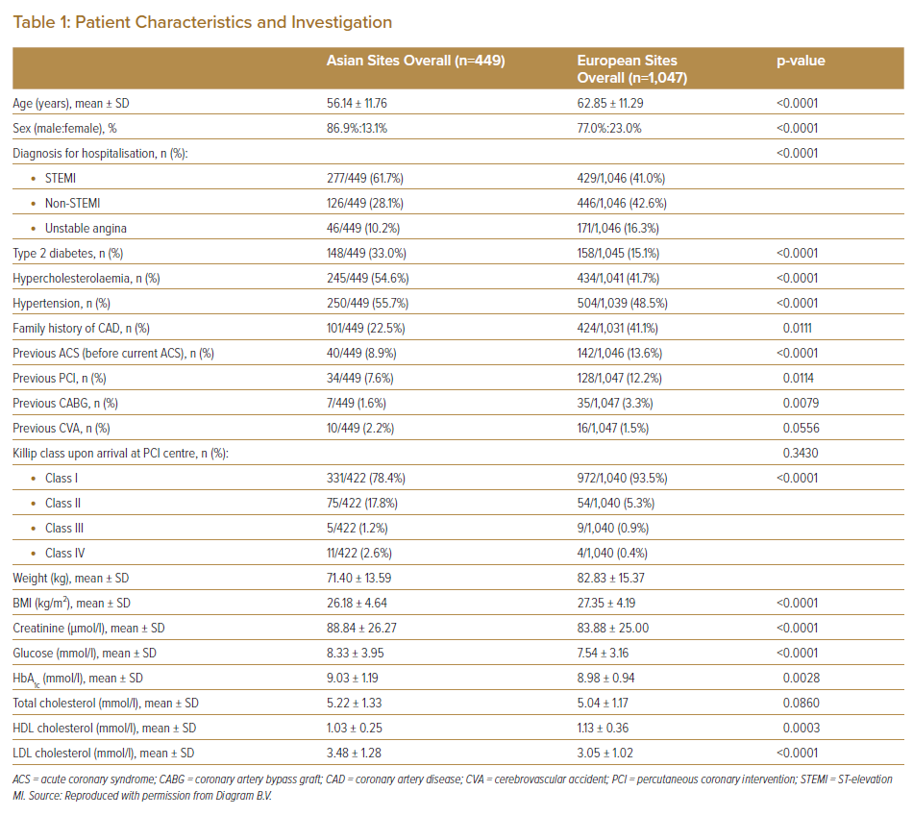
Wan Ahmad WA, Benit E, Camaro C, Kedhi E, Rasoul S, Barbieri L, Lalmand J, van der Schaaf RJ, Koh TH, Hof AWv, Lee SW, Roolvink V, Brouwer MA, DeLuca G, Suryapranata H
Patient Characteristics and Investigation
Citation: Journal of Asian Pacific Society of Cardiology 2022;1:e25.
https://doi.org/10.15420/japsc.2022.02

