Slide 1
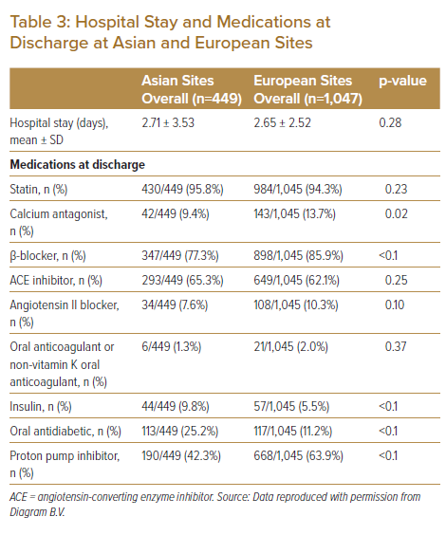
Wan Ahmad WA, Benit E, Camaro C, Kedhi E, Rasoul S, Barbieri L, Lalmand J, van der Schaaf RJ, Koh TH, Hof AWv, Lee SW, Roolvink V, Brouwer MA, DeLuca G, Suryapranata H
Hospital Stay and Medications at Discharge at Asian and European Sites
Citation: Journal of Asian Pacific Society of Cardiology 2022;1:e25.
https://doi.org/10.15420/japsc.2022.02

