Slide 1
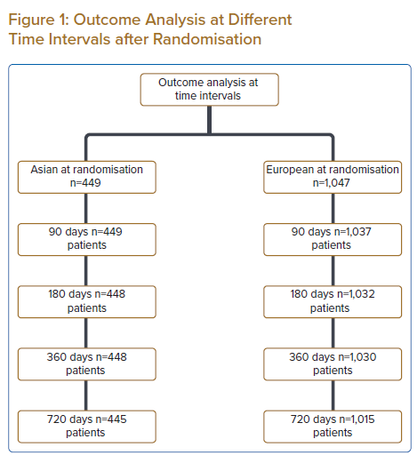
Wan Ahmad WA, Benit E, Camaro C, Kedhi E, Rasoul S, Barbieri L, Lalmand J, van der Schaaf RJ, Koh TH, Hof AWv, Lee SW, Roolvink V, Brouwer MA, DeLuca G, Suryapranata H
Outcome Analysis at Different Time Intervals after Randomisation
Citation: Journal of Asian Pacific Society of Cardiology 2022;1:e25.
https://doi.org/10.15420/japsc.2022.02

