Slide 1
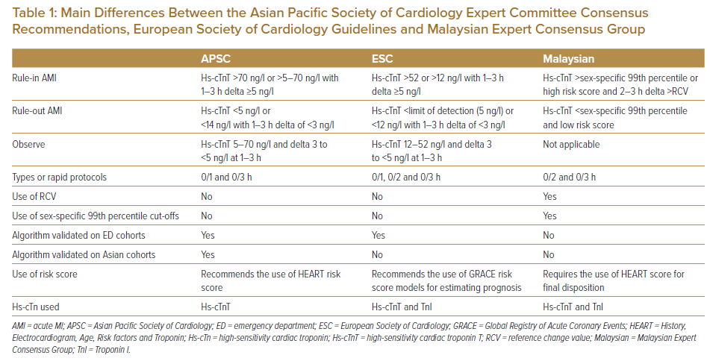
Abdel Wareth LO
Main Differences Between the Asian Pacific Society of Cardiology Expert Committee Consensus Recommendations, European Society of Cardiology Guidelines and Malaysian Expert Consensus Group
Citation: Journal of Asian Pacific Society of Cardiology 2022;1:e26.
https://doi.org/10.15420/japsc.2022.09

