Slide 1
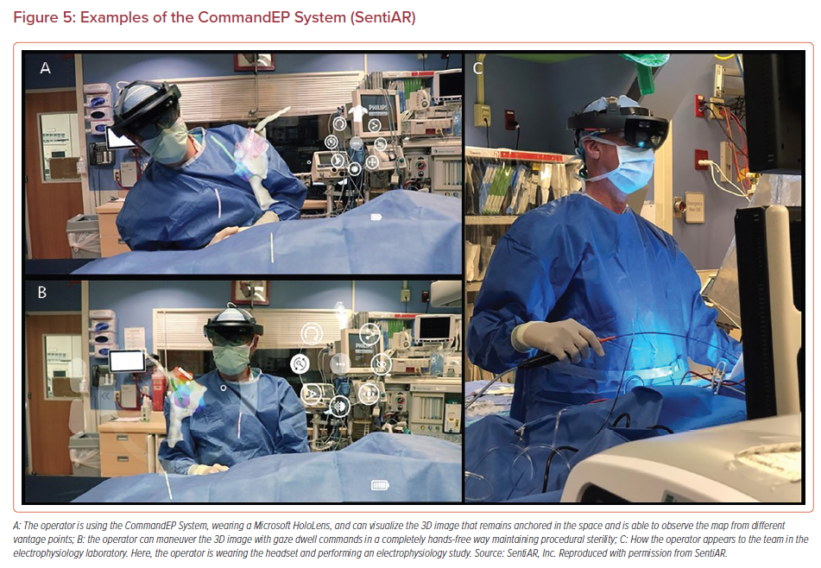
Bloom D, Southworth MK, Silva JR, Avari Silva JN
Examples of the CommandEP System (SentiAR)
Citation: US Cardiology Review 2022;16:e22.
https://doi.org/10.15420/usc.2021.28

