Slide 1
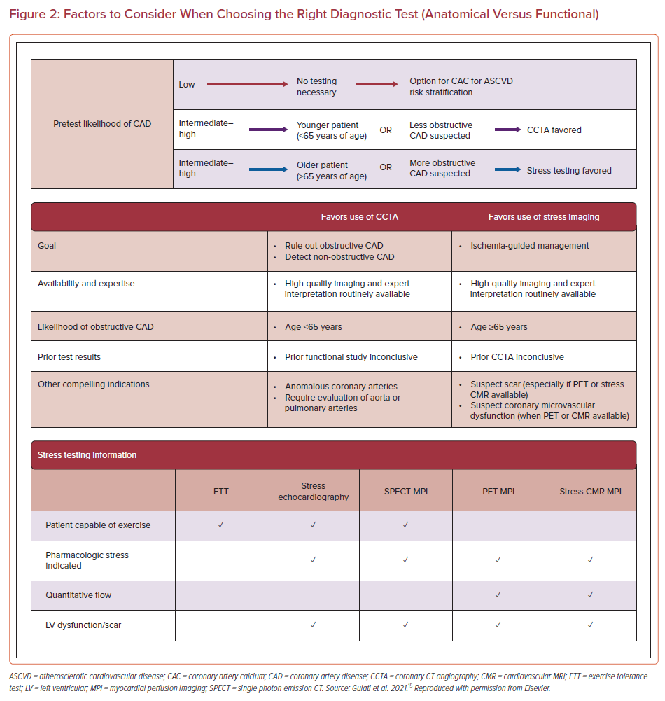
Kaur G, Chand S, Rai D, Baibhav B, Blankstein R, Mukherjee D, Levy P, Gulati M
Factors to Consider When Choosing the Right Diagnostic Test (Anatomical Versus Functional)
Citation: US Cardiology Review 2022;16:e23.
https://doi.org/10.15420/usc.2022.10

