Slide 1
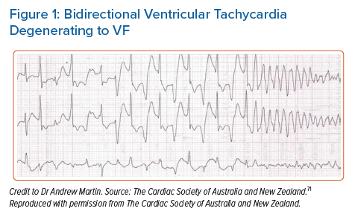
Abbas M, Miles C, Behr ER
Bidirectional Ventricular Tachycardia Degenerating to VF
Citation: Arrhythmia & Electrophysiology Review 2022;11:e20.
https://doi.org/10.15420/aer.2022.09

