Slide 1
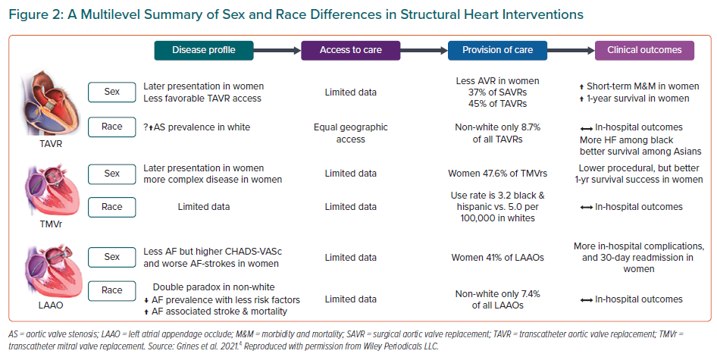
Bullock-Palmer R, Bravo-Jaimes K, Mamas MA, Grines C
A Multilevel Summary of Sex and Race Differences in Structural Heart Interventions
Citation: European Cardiology Review 2022;17:e19.
https://doi.org/10.15420/ecr.2022.23

