Slide 1
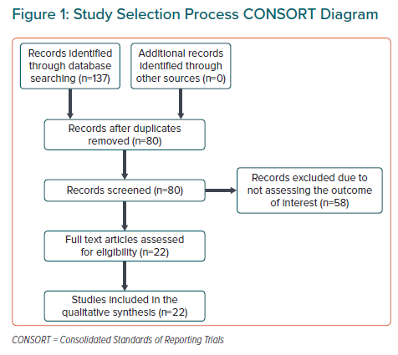
Naik R, Mandal I, Gorog DA
Study Selection Process CONSORT Diagram
Citation: European Cardiology Review 2022;17:e20.
https://doi.org/10.15420/ecr.2022.05

