Slide 1
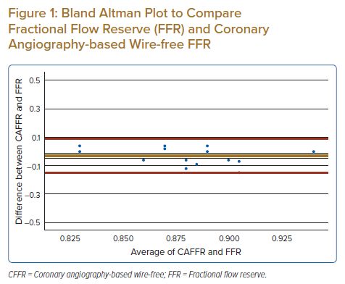
Bhavnani CD, Fong AYY, Koh KT, Pang IX, Chen LS, Ling HS, Thien LK, Khiong CB, Tan CT, Oon YY, Ho KH, Shu FEP, Said A, Cham YL, Ong TK
Bland Altman Plot to Compare Fractional Flow Reserve (FFR) and Coronary Angiography-based Wire-free FFR
Citation: Journal of Asian Pacific Society of Cardiology 2022;1:e28.
https://doi.org/10.15420/japsc.2022.14

