Slide 1
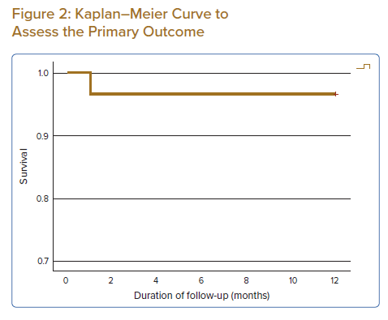
Bhavnani CD, Fong AYY, Koh KT, Pang IX, Chen LS, Ling HS, Thien LK, Khiong CB, Tan CT, Oon YY, Ho KH, Shu FEP, Said A, Cham YL, Ong TK
Kaplan–Meier Curve to Assess the Primary Outcome
Citation: Journal of Asian Pacific Society of Cardiology 2022;1:e28.
https://doi.org/10.15420/japsc.2022.14

