Slide 1
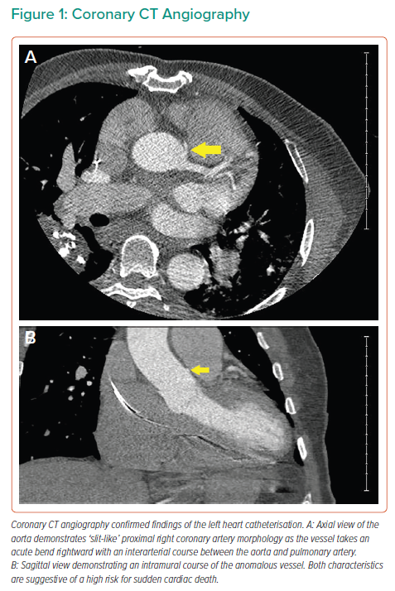
Simon EJ, Ziccardi MR, Sanghvi S, Ardati AK
Coronary CT Angiography
Citation: Interventional Cardiology 2022;17:e16.
https://doi.org/10.15420/icr.2021.24

