Slide 1
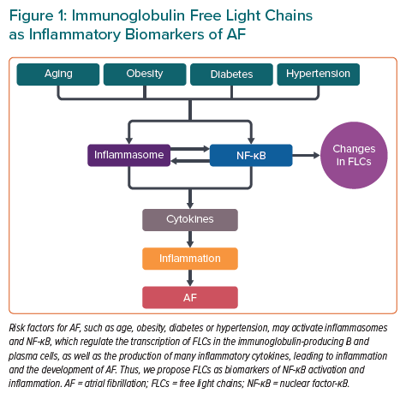
Matsumori A
Immunoglobulin Free Light Chains as Inflammatory Biomarkers of AF
Citation: European Cardiology Review 2022;17:e22.
https://doi.org/10.15420/ecr.2022.30

