Slide 1
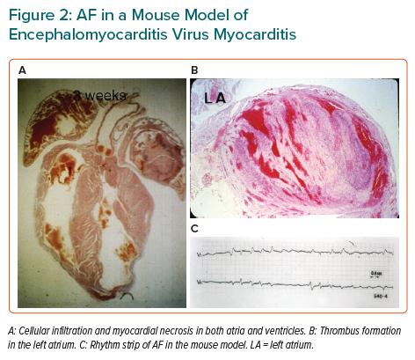
Matsumori A
AF in a Mouse Model of Encephalomyocarditis Virus Myocarditis
Citation: European Cardiology Review 2022;17:e22.
https://doi.org/10.15420/ecr.2022.30

