Slide 1
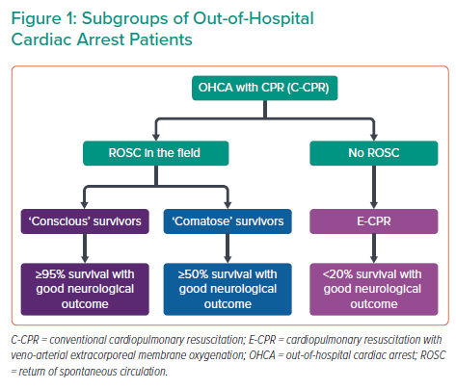
Noc M, Mehran R
Subgroups of Out-of-Hospital Cardiac Arrest Patients
Citation: Interventional Cardiology 2022;17:e17.
https://doi.org/10.15420/icr.2022.25

