Slide 1
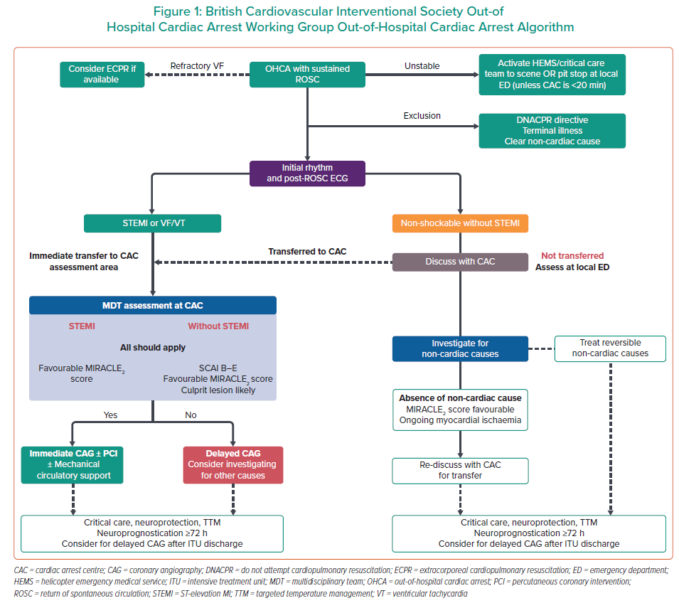
Pareek N, Rees P, Quinn T, Vopelius-Feldt JV, Gallagher S, Mozid A, Johnson T, Gudde E, Simpson R, Glover G, Davies JR, Curzen N, Keeble TR
British Cardiovascular Interventional Society Out-of Hospital Cardiac Arrest Working Group Out-of-Hospital Cardiac Arrest Algorithm
Citation: Interventional Cardiology 2022;17:e18.
https://doi.org/10.15420/icr.2022.09

