Slide 1
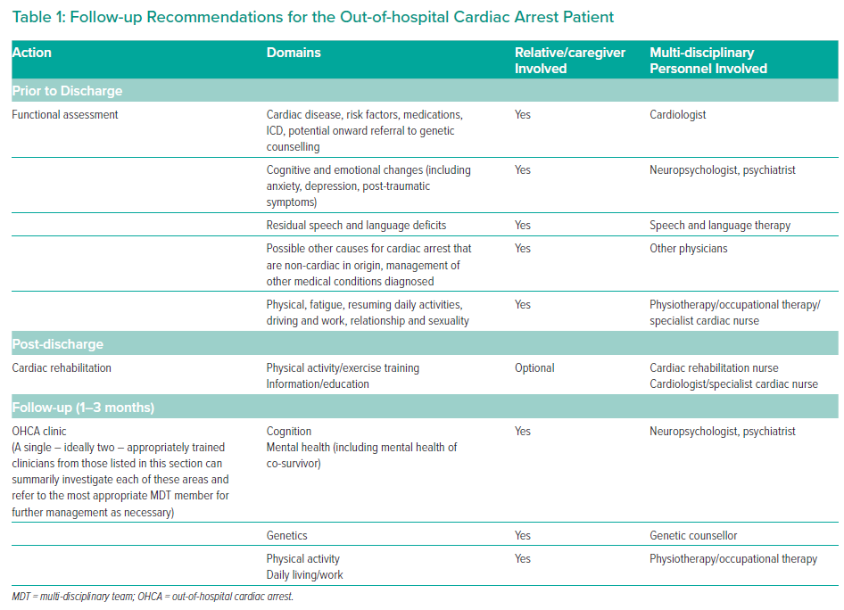
Mion M, Simpson R, Johnson T, Oriolo V, Gudde E, Rees P, Quinn T, Vopelius-Feldt JV, Gallagher S, Mozid A, Curzen N, Davies JR, Swindell P, Pareek N, Keeble TR
Follow-up Recommendations for the Out-of-hospital Cardiac Arrest Patient
Citation: Interventional Cardiology 2022;17:e19.
https://doi.org/10.15420/icr.2022.08

