Slide 1
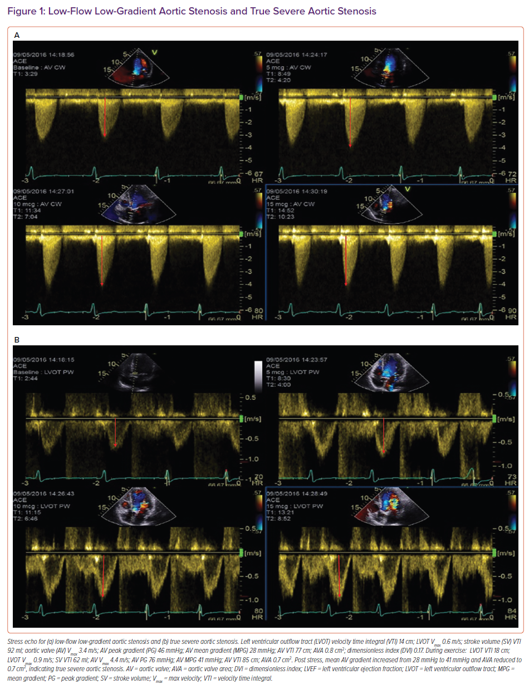
Grigoryan K, Demetrescu C, Kasouridis I, Abiola O, Masci PG, Oguz D, Benedetti G, Mak SM, Parwani P, Preston R, Chiribiri A, Hancock J, Patterson T, Redwood S, Prendergast B, Grapsa J
Low-Flow Low-Gradient Aortic Stenosis and True Severe Aortic Stenosis
Citation: Cardiac Failure Review 2022;8:e31.
https://doi.org/10.15420/cfr.2022.10

