Slide 1
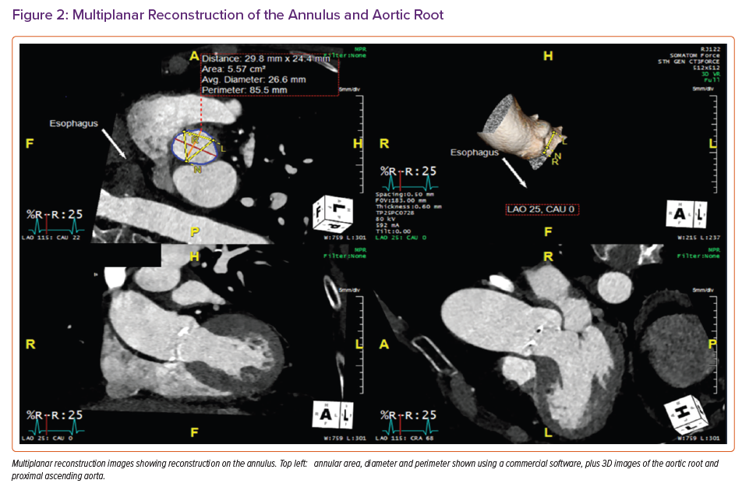
Grigoryan K, Demetrescu C, Kasouridis I, Abiola O, Masci PG, Oguz D, Benedetti G, Mak SM, Parwani P, Preston R, Chiribiri A, Hancock J, Patterson T, Redwood S, Prendergast B, Grapsa J
Multiplanar Reconstruction of the Annulus and Aortic Root
Citation: Cardiac Failure Review 2022;8:e31.
https://doi.org/10.15420/cfr.2022.10

