Slide 1
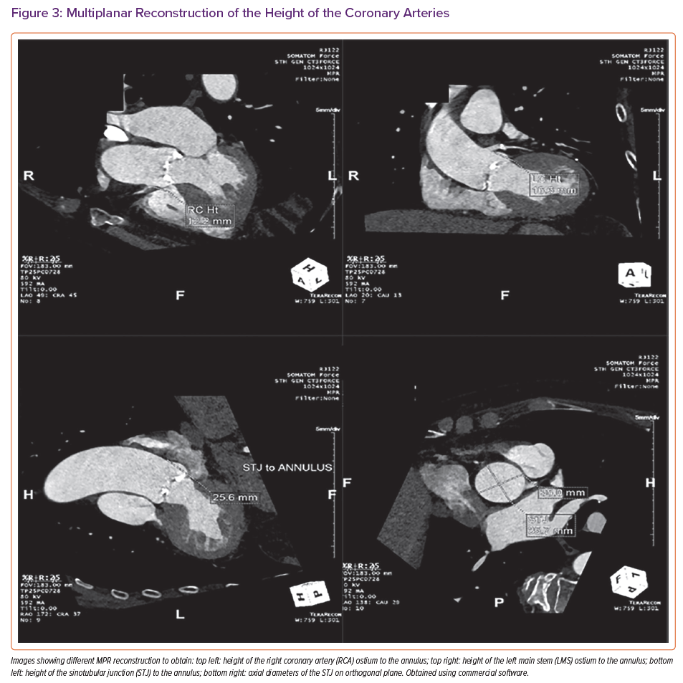
Grigoryan K, Demetrescu C, Kasouridis I, Abiola O, Masci PG, Oguz D, Benedetti G, Mak SM, Parwani P, Preston R, Chiribiri A, Hancock J, Patterson T, Redwood S, Prendergast B, Grapsa J
Multiplanar Reconstruction of the Height of the Coronary Arteries
Citation: Cardiac Failure Review 2022;8:e31.
https://doi.org/10.15420/cfr.2022.10

