Slide 1
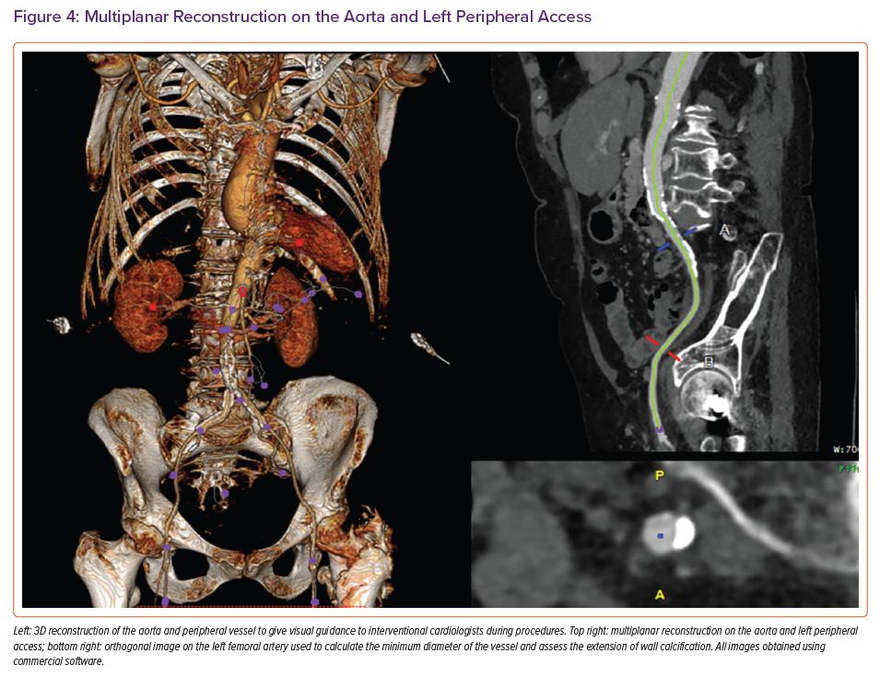
Grigoryan K, Demetrescu C, Kasouridis I, Abiola O, Masci PG, Oguz D, Benedetti G, Mak SM, Parwani P, Preston R, Chiribiri A, Hancock J, Patterson T, Redwood S, Prendergast B, Grapsa J
Multiplanar Reconstruction on the Aorta and Left Peripheral Access
Citation: Cardiac Failure Review 2022;8:e31.
https://doi.org/10.15420/cfr.2022.10

