Slide 1
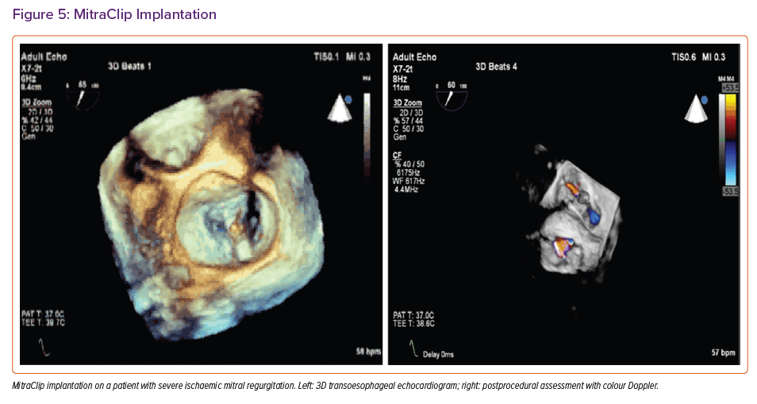
Grigoryan K, Demetrescu C, Kasouridis I, Abiola O, Masci PG, Oguz D, Benedetti G, Mak SM, Parwani P, Preston R, Chiribiri A, Hancock J, Patterson T, Redwood S, Prendergast B, Grapsa J
MitraClip Implantation
Citation: Cardiac Failure Review 2022;8:e31.
https://doi.org/10.15420/cfr.2022.10

