Slide 1
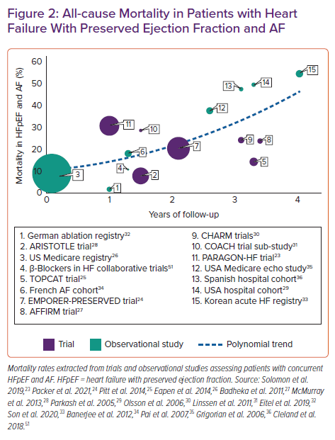
Țica O, Khamboo W, Kotecha D
All-cause Mortality in Patients with Heart Failure With Preserved Ejection Fraction and AF
Citation: Cardiac Failure Review 2022;8:e32.
https://doi.org/10.15420/cfr.2022.03

