Slide 1
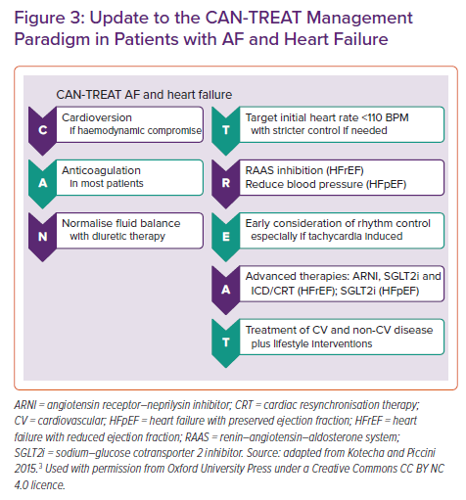
Țica O, Khamboo W, Kotecha D
Update to the CAN-TREAT Management Paradigm in Patients with AF and Heart Failure
Citation: Cardiac Failure Review 2022;8:e32.
https://doi.org/10.15420/cfr.2022.03

