Slide 1
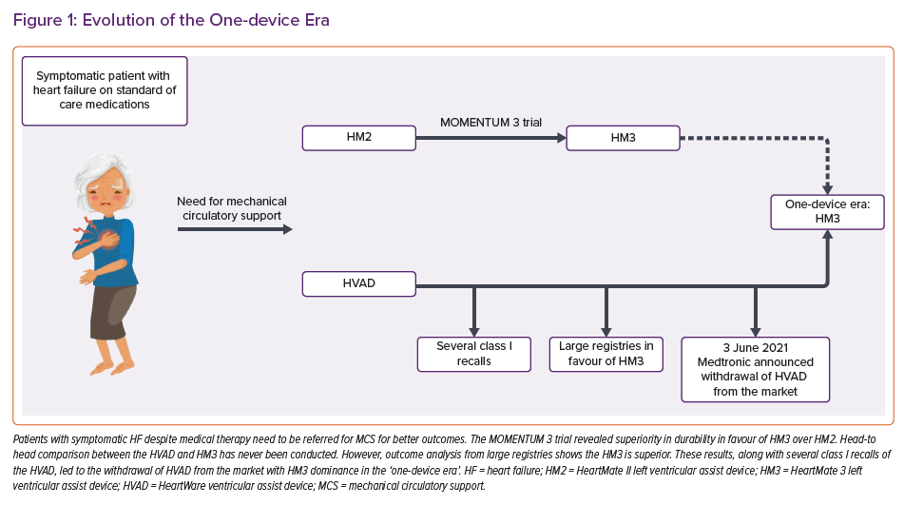
Moady G, Atar S, Ben-Avraham B, Ben-Gal T
Evolution of the One-device Era
Citation: Cardiac Failure Review 2022;8:e33.
https://doi.org/10.15420/cfr.2022.01

