Slide 1
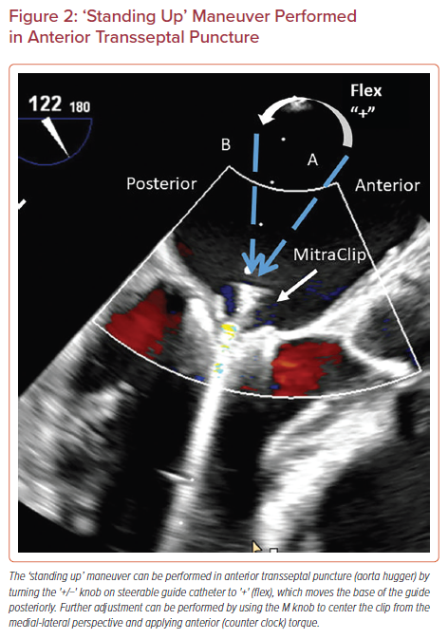
Sharma V, Sothwal A, Parekh J, Panaich S
‘Standing Up’ Maneuver Performed in Anterior Transseptal Puncture
Citation: US Cardiology Review 2022;16:e24.
https://doi.org/10.15420/usc.2022.11

