Slide 1
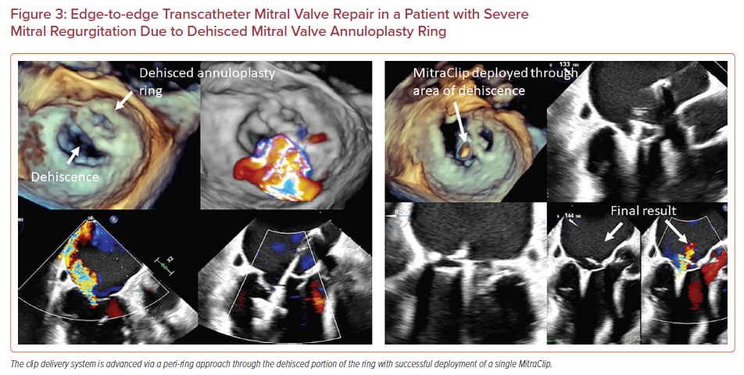
Sharma V, Sothwal A, Parekh J, Panaich S
Edge-to-edge Transcatheter Mitral Valve Repair in a Patient with Severe Mitral Regurgitation Due to Dehisced Mitral Valve Annuloplasty Ring
Citation: US Cardiology Review 2022;16:e24.
https://doi.org/10.15420/usc.2022.11

