Slide 1
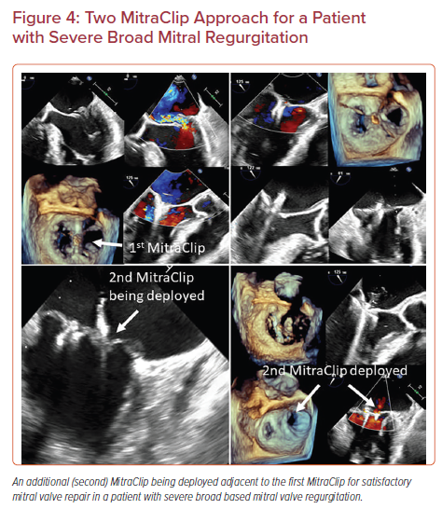
Sharma V, Sothwal A, Parekh J, Panaich S
Two MitraClip Approach for a Patient with Severe Broad Mitral Regurgitation
Citation: US Cardiology Review 2022;16:e24.
https://doi.org/10.15420/usc.2022.11

