Slide 1
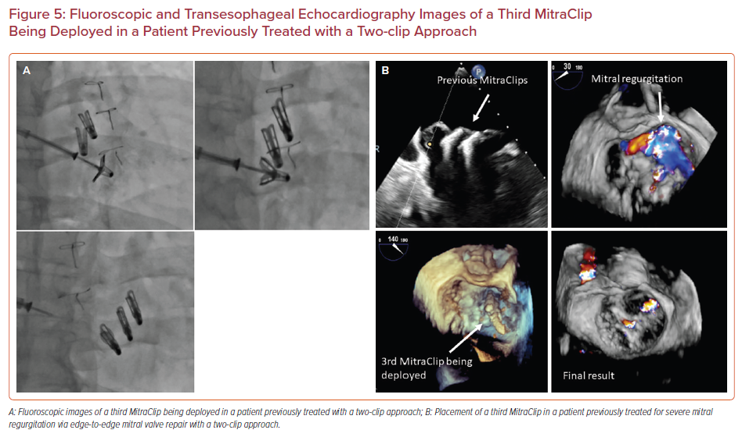
Sharma V, Sothwal A, Parekh J, Panaich S
Fluoroscopic and Transesophageal Echocardiography Images of a Third MitraClip Being Deployed in a Patient Previously Treated with a Two-clip Approach
Citation: US Cardiology Review 2022;16:e24.
https://doi.org/10.15420/usc.2022.11

