Slide 1
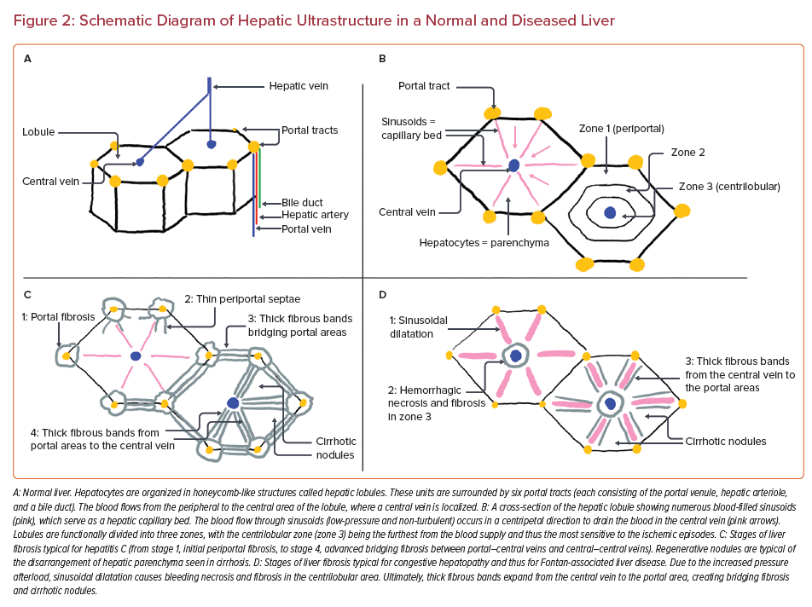
Cieplucha A, Budts W, Gewillig M, Bruaene AVD
Schematic Diagram of Hepatic Ultrastructure in a Normal and Diseased Liver
Citation: US Cardiology Review 2022;16:e25.
https://doi.org/10.15420/usc.2022.02

